Slide 1


<Saira Banu>
<11-OCT-2023>

Slide 2

Outline
Executive Summary
Introduction
Methodology
Results
Conclusion
Appendix

Slide 3
Executive Summary
Summary of methodologies
Data Collection with SpaceX API and Web Scraping from Wikipedia page.
Data Wrangling
Exploratory Data Analysis (EDA) with SQL , Pandans and Matplotlip
Interactive Visual Analytics and Dashboard with Folium and Plotly Dash
Machine Learning Prediction - Predictive aAnalysis (Classification)
Summary of all results
Results from Interactive Visual Analytics
Presenting Best Hyperparameter for SVM, Classification Trees and Logistic Regression
Method that performs best using test data with the accuracy score

Slide 4
Introduction
Project background and context
Space X a rocket launch company, helps in rocket launches in an inexpensive cost compare to other companies in the market. This is because Space X can reuse the first stage.
The context here is to determine if first stage will land, and cost of its launch. This information can be used if an alternate company wants to bid against space X for a rocket launch. This goal of the project is to create a machine learning pipeline to predict if the first stage will land successfully.
Problems you want to find answers
What factors determine if the rocket will land successfully?
The interaction amongst various features that determine the success rate of a successful landing. OR Where is the best place to make launches.?
What operating conditions needs to be in place to ensure a successful landing program.
The best way to estimate the total cost for launches, by predicting successful landings of the first stage of rockets.

Slide 5

Section 1

Slide 6
Methodology
Executive Summary
Data collection methodology:
Data from Space X was obtained from 2 sources:
Space X API(https://api.spacexdata.com/v4/rockets/) •
WebScraping (https://en.wikipedia.org/wiki/List_of_Falcon/_9/_and_Falcon_Heavy_launches)
Perform data wrangling
The Collected data was in Json format, After downloading the data from the above sites. The data was parsed using Beautiful soup and later was converted into a Pandas Data Frame.
One hot encoding was performed to enrich the data and created respective labels or features in analyzing it further

Slide 7
Methodology
Executive Summary
Perform exploratory data analysis (EDA) using visualization and SQL
Perform interactive visual analytics using Folium and Plotly Dash
Perform predictive analysis using classification models
Predictive analysis was performed with the help of Machine Learning – Classification Algorithm
For this the data was normalized, divided or was splitted into training and testing set along with an dependent variable as a separate feature.
Later the training set was fitted based on the algorithms and accuracy was calculated and the best method was selected

Slide 8
Data Collection
Main objective for Data Collection step:
Request to the SpaceX API
Clean the requested data
Perform basic data formatting to create a data frame using pandas
Analyze the data and select features which provide Launch details
Make a get request to SpaceX API
Deal with missing Values (perform basic Wrangling steps)
Filter the data frame to only include Falcon 9 launches
Construct dataset with the specific launch details required
Source Code : https://github.com/Sair07/Applied_data_science_capstone/blob/main/spacex-data-collection.ipynb

Slide 9
Data Collection - Scraping
performing web scraping to collect Falcon 9 historical launch records
Wikipedia link https://en.wikipedia.org/wiki/List_of_Falcon_9_and_Falcon_Heavy_launches
Applying basic BeautifulSoup Python library to scrape webpages for data and filter the data
Request the Falcon9 Launch Wiki page from its URL
Extract all column/variable names from the HTML table header
Create a data frame by parsing the launch HTML tables
Filter and Scrape data from HTML tables using Beautiful Soup object
Source code: https://github.com/Sair07/Applied_data_science_capstone/blob/main/webscraping.ipynb
https://github.com/Sair07/Applied_data_science_capstone/blob/main/labs_module%201_Web%20Scraping_Web-Scraping-Review-Lab.ipynb

Slide 10
Data Wrangling
Performing Exploratory Data Analysis (EDA) on the dataset using Pandas.
After loading the dataset into pandas check the summary of the data
drill down to each site visualize its detailed launch records
Visualize the relationship between features in the dataset
Finally, select the features that will be used in success prediction in the future module
EDA
Summarization
Features Engineering
Introducing a new/selecting feature for future predictions
Source Code : https://github.com/Sair07/Applied_data_science_capstone/blob/main/Spacex-data_wrangling.jupyterlite.ipynb

Slide 11
EDA with Data Visualization
﻿﻿Catplot to visualize the relationship between Flight Number and Payload.
﻿﻿Catplot to visualize the relationship between Flight Number and Launch Site.
﻿﻿Catplot to visualize the relationship between Payload and Launch Site.
﻿﻿Bar chart to visualize the relationship between success rate of each Orbit type.
﻿Catplot to visualize the relationship between Flight Number and Orbit type.
﻿﻿Catplot to visualize the relationship between Payload and Orbit type.
﻿﻿Line chart to visualize the launch success early trend
Source Code : https://github.com/Sair07/Applied_data_science_capstone/blob/main/EDA%20with%20Visualization.ipynb

Slide 12
EDA with SQL
Display the names of the unique launch sites in the space mission
%sql select distinct(Launch_Site) from SPACEXTABLE
Display 5 records where launch sites begin with the string 'CCA’
%sql select * from SPACEXTABLE where Launch_Site like "%CCA%" limit 5;
Display the total payload mass carried by boosters launched by NASA (CRS)
%sql select sum(PAYLOAD_MASS__KG_) ,Booster_Version,Customer from SPACEXTABLE where Customer like '%NASA%' group by Booster_Version;
Display average payload mass carried by booster version F9 v1.1
%sql select avg(PAYLOAD_MASS__KG_) from SPACEXTABLE where Booster_Version like '%%F9 v1.1’
List the date when the first succesful landing outcome in ground pad was acheived.
%sql SELECT MIN(DATE) AS first_ successful_ landing FROM SPACEXTBL WHERE (landing_outcome)='Success (ground pad)';

Slide 13
EDA with SQL
Display the names of the unique launch sites in the space mission
%sql select distinct(Launch_Site) from SPACEXTABLE
List the names of the boosters which have success in drone ship and have payload mass greater than 4000 but less than 6000
%sql select Booster_Version,PAYLOAD_MASS__KG_ from SPACEXTABLE where Landing_Outcome = 'Success (drone ship)’ and PAYLOAD_MASS__KG_ between 4000 and 6000;
List the total number of successful and failure mission outcomes
%sql select count(Mission_Outcome),Mission_Outcome from SPACEXTABLE group by Mission_Outcome;
List the names of the booster_versions which have carried the maximum payload mass. Use a subquery
%%sqlselect distinct(Booster_Version) from SPACEXTABLE where Booster_Version in (select Booster_Version where PAYLOAD_MASS__KG_ > 15000);
Source Code : https://github.com/Sair07/Applied_data_science_capstone/blob/main/EDA%20with%20SQL.ipynb

Slide 14
Build an Interactive Map with Folium
Summary of map objects that were created and added to the Folium map
﻿﻿folium. Circle and folium.Marker to add a highlighted circle area with a text label on a specific coordinate for each launch site on the site map.
﻿﻿MarkerClusterobject for simplify a map containing multiple markers that has the same coordinate.
﻿﻿﻿﻿Circles indicate highlighted areas around specific coordinates, like NASA Johnson Space Center
Lines are used to indicate distances between two coordinates.
Source Code : https://github.com/Sair07/Applied_data_science_capstone/blob/main/Interactive_map_Folium.ipynb

Slide 15
Build a Dashboard with Plotly Dash
The dashboard application contains input components as mentioned below to interact with a pie chart and a scatter point chart.
dropdown list
range slider
﻿﻿A launch Site Drop-down Input Component, contains four different launch sites and a dropdown menu let us select different launch sites with a select all option
﻿﻿A callback function to render success-pie-chart based on selected site from dropdown.This callback function gets the selected launch site from site-dropdown and render a pie chart visualizing launch success counts.
﻿﻿A range Slider to Select Payload , to easily select different payload range and see if we can identify some visual patterns.

Slide 16
Build a Dashboard with Plotly Dash
A callback function to render the success-payload-scatter-chart scatter plot.To visually observe how payload may be correlated with mission outcomes for selected sites and also collective for all sites based on the drop down value.
Source Code: https://github.com/Sair07/Applied_data_science_capstone/blob/main/space_dash_app.py

Slide 17
Predictive Analysis (Classification)
Summary of the model development process
﻿﻿Creation of a NumPy array from the dependant column Class in data.
﻿﻿Data standardization using standard scaler preprocessing method
﻿﻿Use of the function train_test_split to split the data X and Y into training and test data.
﻿﻿Searching for the best Hyperparameters for Logistic Regression, SVM, Decision Tree and KN classifiers, by calculating the accuracy after training the dataset
﻿﻿Find the method performs best using test data
Source Code: https://github.com/Sair07/Applied_data_science_capstone/blob/main/SpaceX_Machine_Learning_Prediction.jupyterlite.ipynb

Slide 18
Results
Exploratory data analysis results
Space X uses 4 different launch sites;
The average payload of F9 v1.1 booster is 2,928 kg;
The first success landing outcome happened in 2015-12-22;
Many Falcon 9 booster versions were successful at landing in drone ships having payload above the average;
Almost 100% of mission outcomes were successful;
Two booster versions failed at landing in drone ships in 2015: F9 v1.1 B1012 and F9 v1.1 B1015;
The number of landing outcomes became as better as years passed (14 success and 5 Failure)

Slide 19
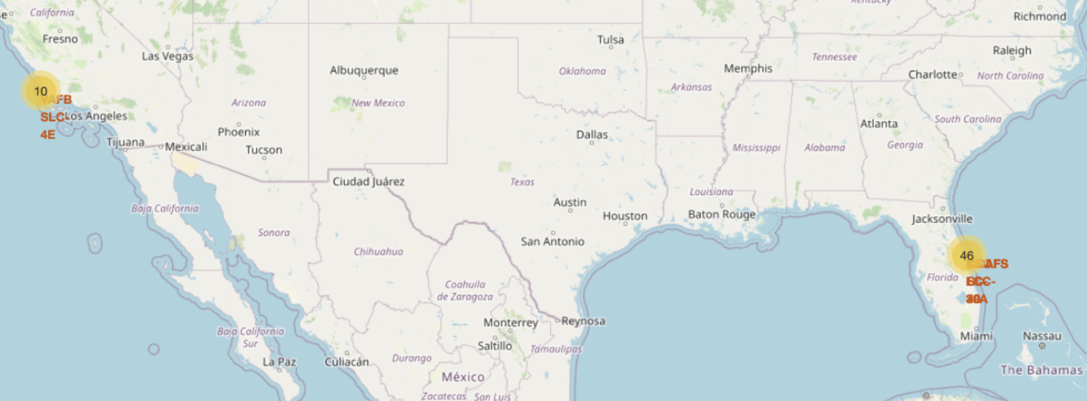
Results
Interactive analytics demo in screenshots
Using interactive analytics was possible to identify that launch sites is safety places, near sea, as shown below with a map derived from Folium
Predictive analysis results

Slide 20
Results
Predictive analysis results
Predictive Analysis showed that Decision Tree Classifier is the best model to predict successful landings, having accuracy over 87% and accuracy for test data over 94%.
Descision Tree came best out of logistic regression, support vector machine, decision tree and k nearest neighbors.

Slide 21

Section 2

Slide 22
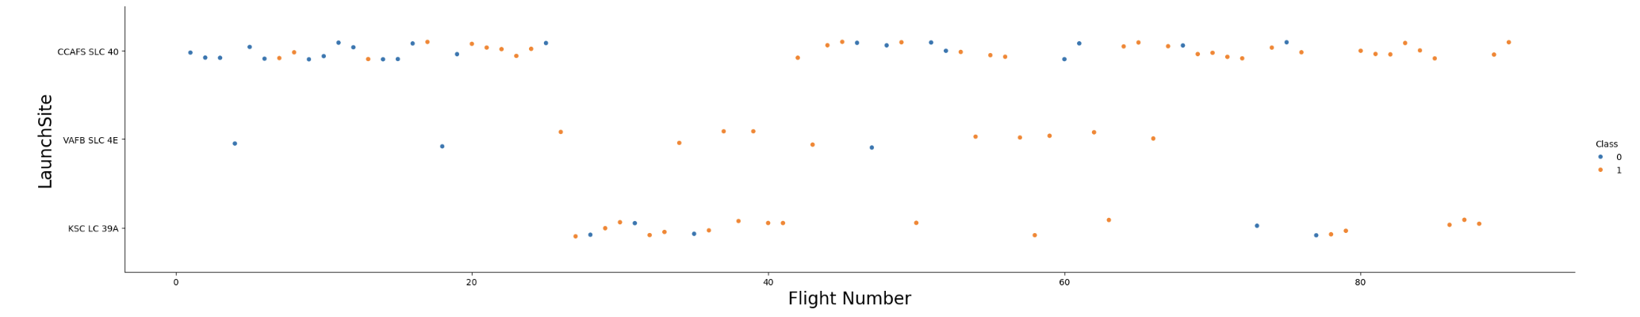
Flight Number vs. Launch Site
scatter plot of Flight Number vs. Launch Site
Its clear from the the above graph that success rate has improved over time.
According to the plot, the best launch site nowadays is CCAF5 SLC 40, where most of recent launches were successful.
VAFB SLC 4E is second and third place KSC LC 39A;

Slide 23
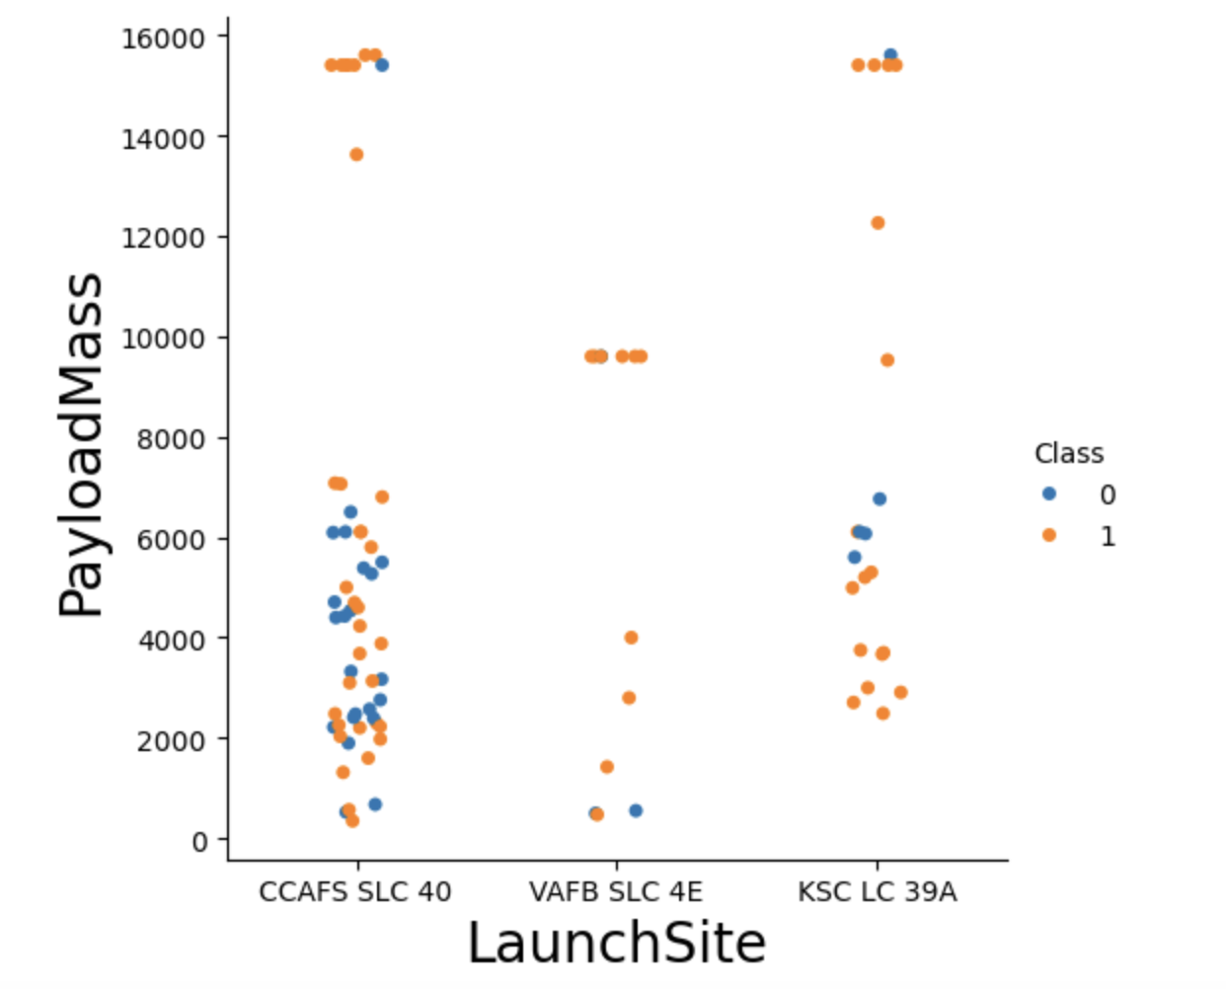
Payload vs. Launch Site
Payloads over 9,000kg have good success rate;
Payloads over 12,000kg seems to be possible only on CCAFS SLC 40 and KSC LC 39A launch sites.

Slide 24
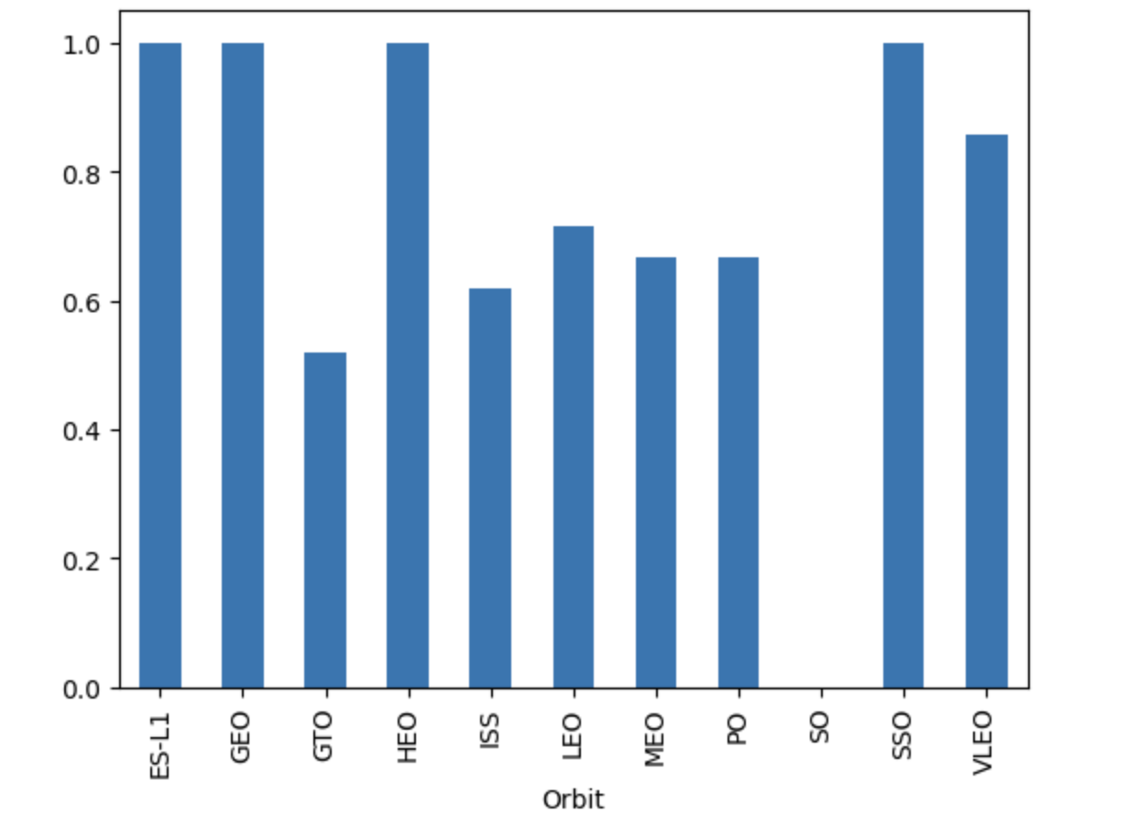
Success Rate vs. Orbit Type
The biggest success rates happens to orbits:
ES-L1
GEO
HEO
SSO

Slide 25
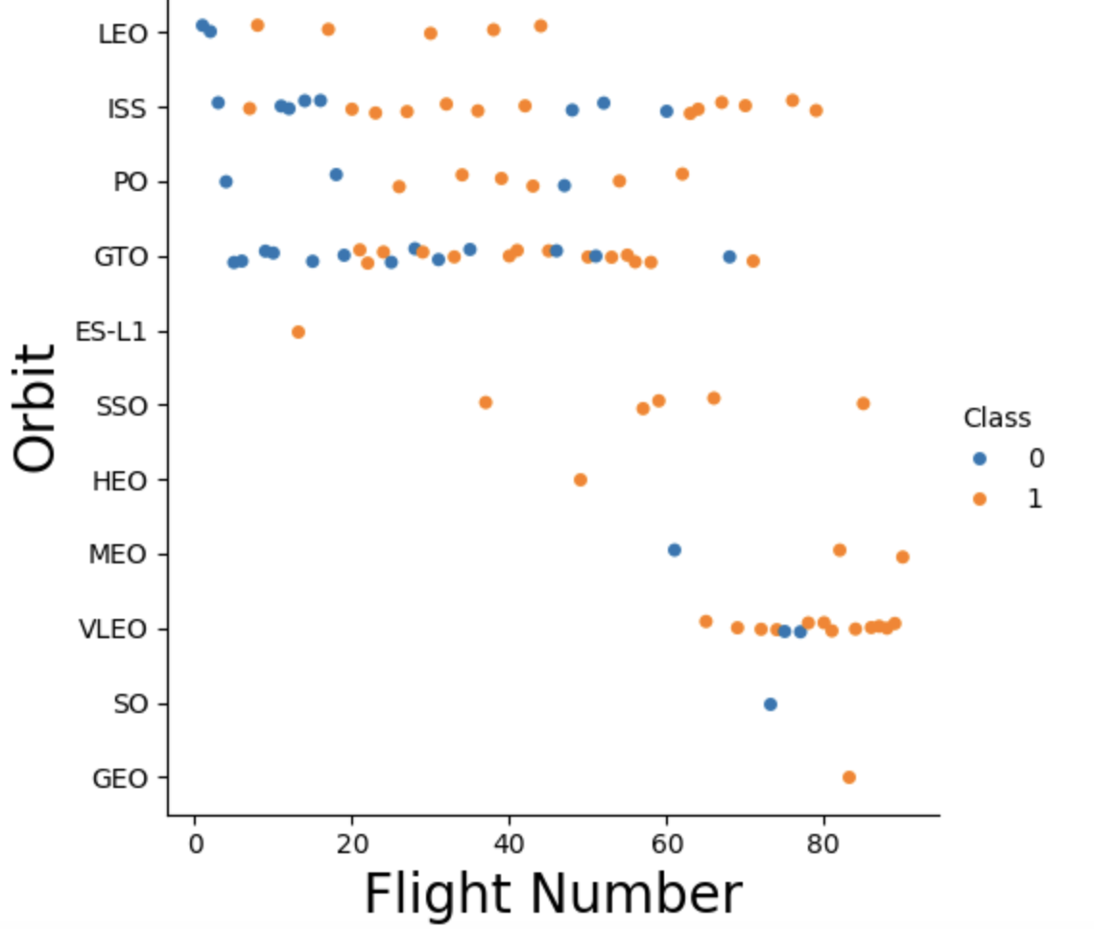
Flight Number vs. Orbit Type
success rate improved over time to all orbits.
VLEO orbit looks good as it has good success launches.

Slide 26
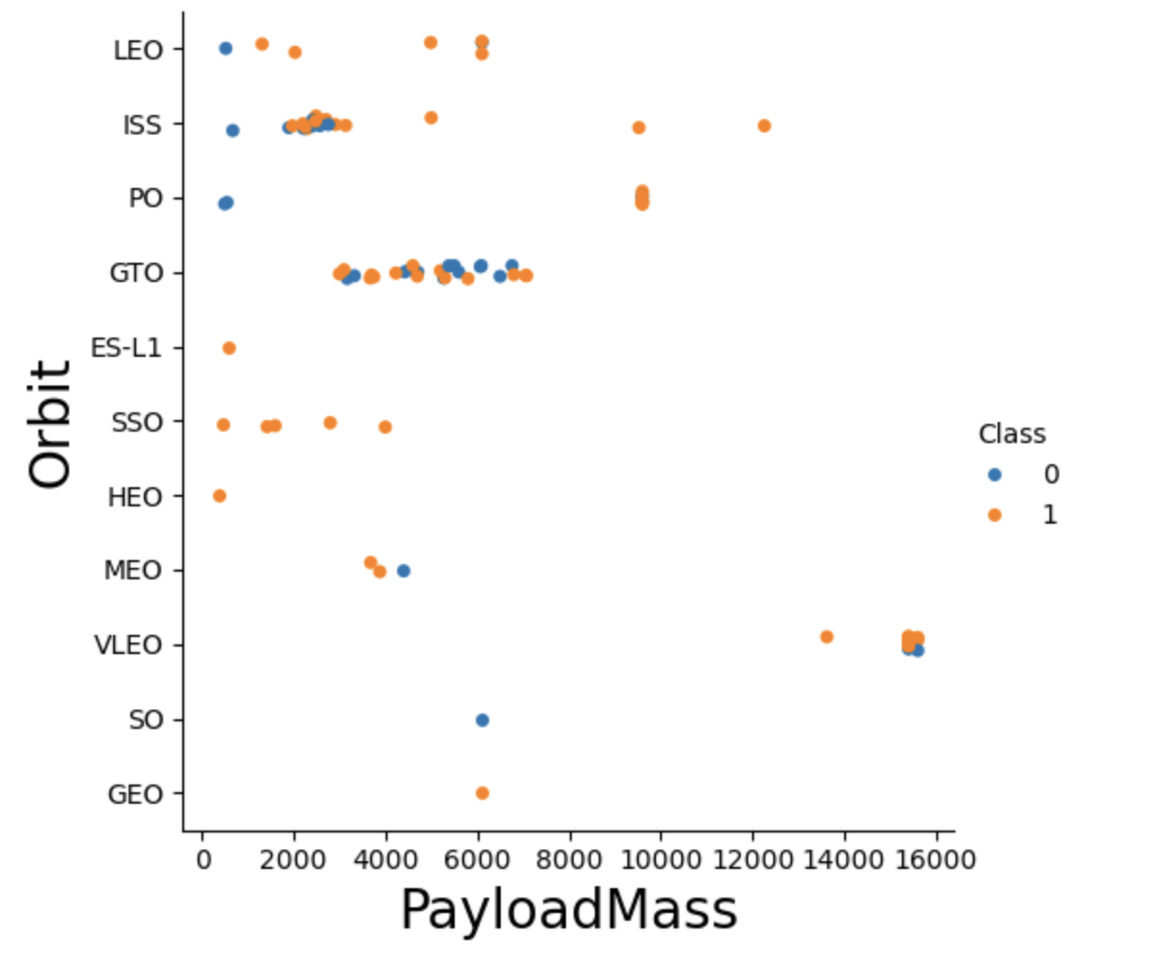
Payload vs. Orbit Type
There is no relation between payload and success rate to orbit GTO as it has mixed results
ISS orbit has wide range of payload and with high success rate
There are less launches to the orbits SO and GEO.

Slide 27
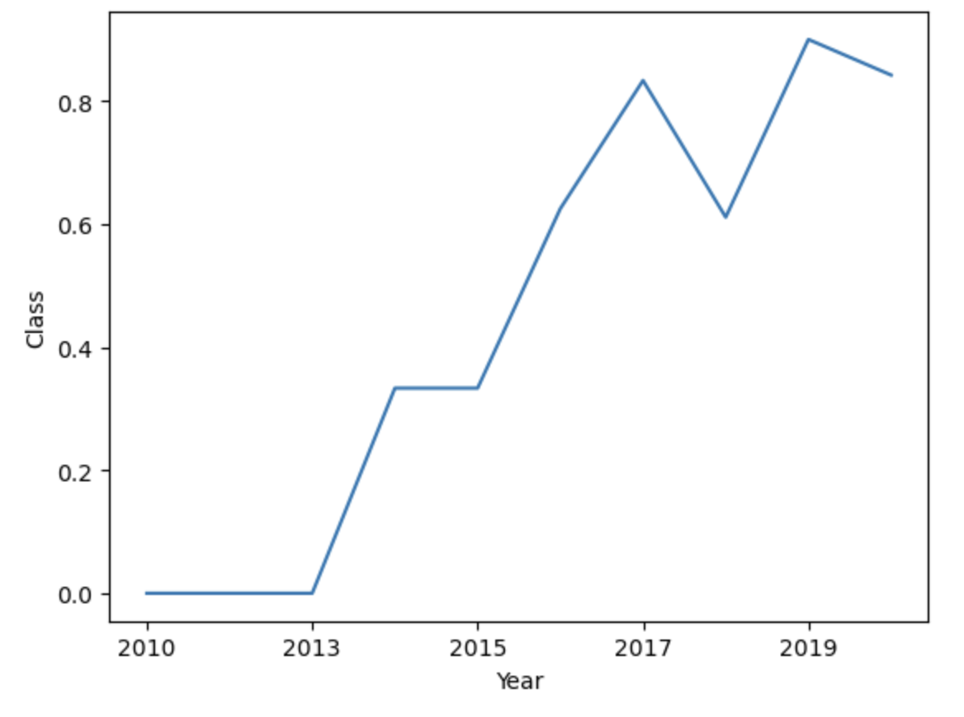
Launch Success Yearly Trend
Success rate started improving from 2013
First 3 years looks like learning years to get hands on the technology with no success

Slide 28
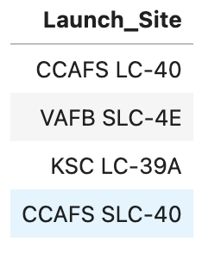
All Launch Site Names
Names of the unique launch sites
They are obtained by selecting unique occurrences of “launch_site” values from the dataset.
Query: select distinct(Launch_Site) from SPACEXTABLE

Slide 29
Launch Site Names Begin with 'CCA'
Date | Time (UTC) | Booster_Version | Launch_Site | Payload | PAYLOAD_MASS__KG_ | Orbit | Customer | Mission_Outcome | Landing_Outcome
2010-04-06 | 18:45:00 | F9 v1.0 B0003 | CCAFS LC-40 | Dragon Spacecraft Qualification Unit | 0 | LEO | SpaceX | Success | Failure (parachute)
2010-08-12 | 15:43:00 | F9 v1.0 B0004 | CCAFS LC-40 | Dragon demo flight C1, two CubeSats, barrel of Brouere cheese | 0 | LEO (ISS) | NASA (COTS) NRO | Success | Failure (parachute)
2012-05-22 | 07:44:00 | F9 v1.0 B0005 | CCAFS LC-40 | Dragon demo flight C2 | 525 | LEO (ISS) | NASA (COTS) | Success | No attempt
2012-08-10 | 00:35:00 | F9 v1.0 B0006 | CCAFS LC-40 | SpaceX CRS-1 | 500 | LEO (ISS) | NASA (CRS) | Success | No attempt
2013-01-03 | 15:10:00 | F9 v1.0 B0007 | CCAFS LC-40 | SpaceX CRS-2 | 677 | LEO (ISS) | NASA (CRS) | Success | No attempt
5 records where launch sites begin with `CCA`
Query: select * from SPACEXTABLE where Launch_Site like "%CCA%" limit 5;

Slide 30
Total Payload Mass
Total payload carried by boosters from NASA
Query: select sum(PAYLOAD_MASS__KG_) ,Booster_Version,Customer from SPACEXTABLE where Customer like '%NASA%' group by Booster_Version;
Query to Total payload calculated above, by summing all payloads whose codes contain ‘CRS’, which corresponds to NASA.

Slide 31
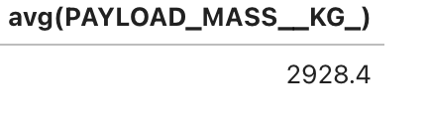
Average Payload Mass by F9 v1.1
Calculate the average payload mass carried by booster version F9 v1.1
Query : select avg(PAYLOAD_MASS__KG_) from SPACEXTABLE where Booster_Version like '%%F9 v1.1’
Filtering data by the booster version above and calculating the average payload mass using avg() function we obtained the value of 2,928 kg.

Slide 32
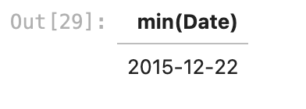
First Successful Ground Landing Date
Date of the first successful landing outcome on ground pad
Query: SELECT MIN(DATE) AS first_successful_landing FROM SPACEXTBL WHERE (landing_outcome)='Success (ground pad)’;
Using the min function and filtering on the landing outcome.

Slide 33
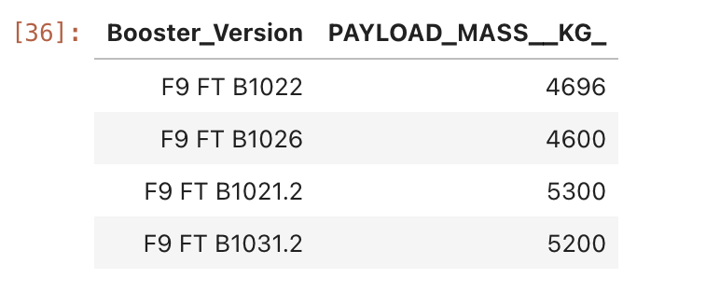
Successful Drone Ship Landing with Payload between 4000 and 6000
Names of boosters which have successfully landed on drone ship and had payload mass greater than 4000 but less than 6000
Query: select Booster_Version,PAYLOAD_MASS__KG_ from SPACEXTABLE where Landing_Outcome = 'Success (drone ship)' and PAYLOAD_MASS__KG_ between 4000 and 6000;
By filtering the given range on the payload mass Kg column and landing outcome we can see the above 4 booster had success landing

Slide 34
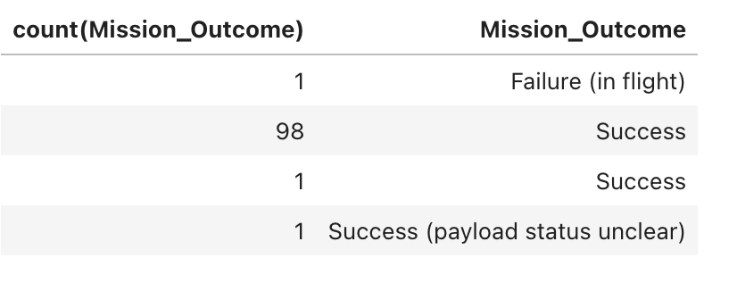
Total Number of Successful and Failure Mission Outcomes
Calculate the total number of successful and failure mission outcomes
Query: select count(Mission_Outcome),Mission_Outcome from SPACEXTABLE group by Mission_Outcome;
Just by using the group by clause we can get the clear detail on the failure and success outcomes

Slide 35
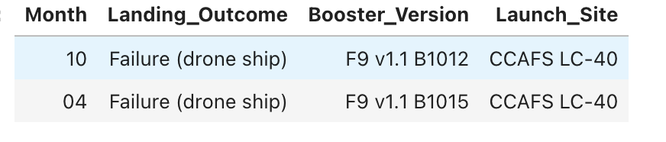
2015 Launch Records
List the failed landing_outcomes in drone ship, their booster versions, and launch site names for in year 2015
Query: select substr(Date, 6,2) as "Month",Landing_Outcome, Booster_Version,Launch_Site from SPACEXTABLE where substr(Date,0,5)='2015' and Landing_Outcome ='Failure (drone ship)' limit 10;
use substr(Date, 6,2) as month to get the months and substr(Date,0,5)='2015' for year.

Slide 36
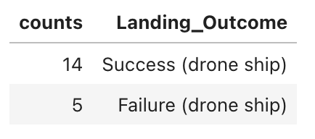
Rank Landing Outcomes Between 2010-06-04 and 2017-03-20
Rank the count of landing outcomes (such as Failure (drone ship) or Success (ground pad)) between the date 2010-06-04 and 2017-03-20, in descending order
QUERY: select count(Landing_Outcome) as counts,Landing_Outcome from SPACEXTABLE where Landing_Outcome = 'Failure (drone ship)' or Landing_Outcome = 'Success (drone ship)’ group by Landing_Outcome order by counts desc;

Slide 37

Section 3

Slide 38
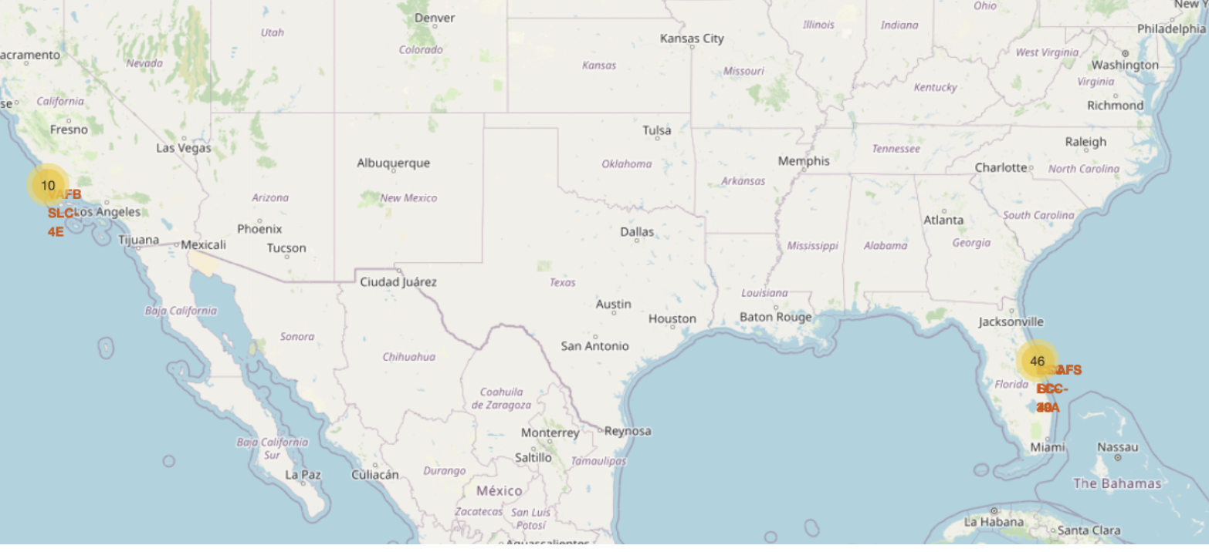
Success/Failed Launches For Each Site
The map shows clusters for every launch site, the second shows a red marker for a failed launch.

Slide 39
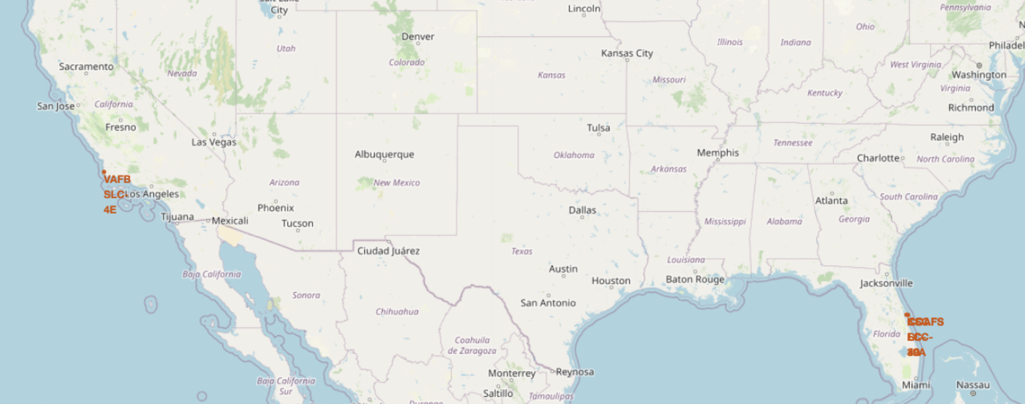
All Launch Site
All Launch sites are in close proximity to the coast

Slide 40
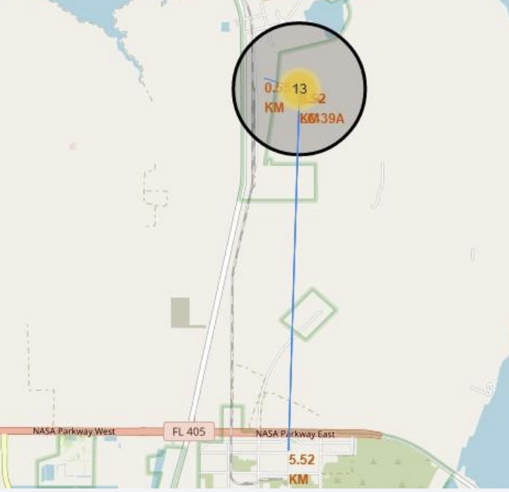
Proximity of Launch Site
Launch sites are near to railways, roads, highways and coastline.

Slide 41

Section 4

Slide 42
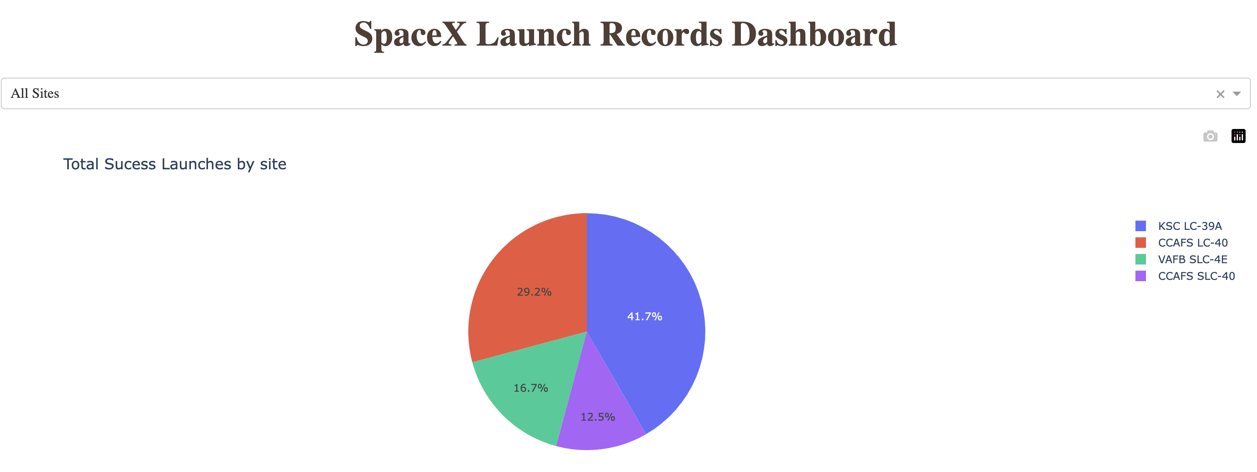
Success Launches by ALL sites
KSC LC-39A is the site with the higher success launches followed by CCAFS LC-40. Also the place of launch seems to have an important factor in success of missions.

Slide 43
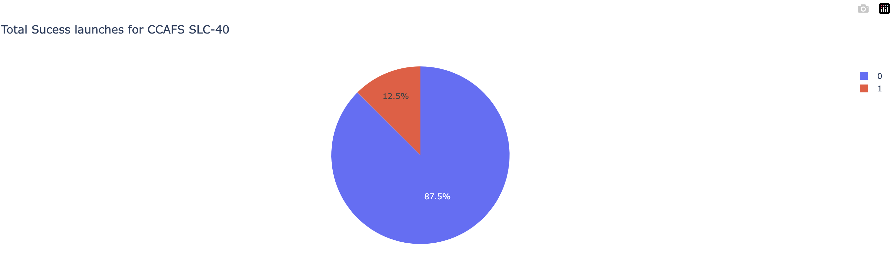
Launch Site with Highest Success Rate
Launch Site CCAFS SLC-40 has the highest success rate of 87.5%
Also from this interactive dash site we see that this is very close to the second best launch site VAFB SLC-4E which is having highest success rate of 83.3%

Slide 44
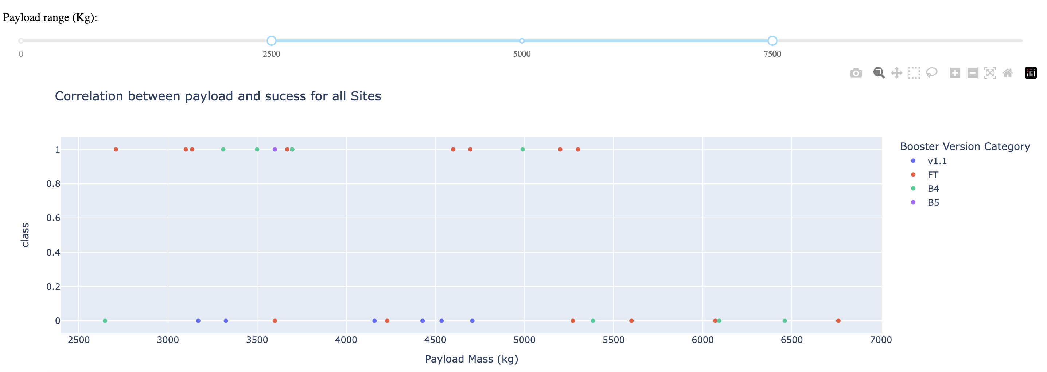
<Dashboard Screenshot 3>
Payload Vs the Success rate with a range slider to view in the specific range of payload.Scatter plot for all sites with 2500(kg) to 7000(kg) payload ranges.
The 2500-5000(kg) range concentrate the majority of the successfully launches and has all success rates up to 5500(KG)

Slide 45

Section 5

Slide 46
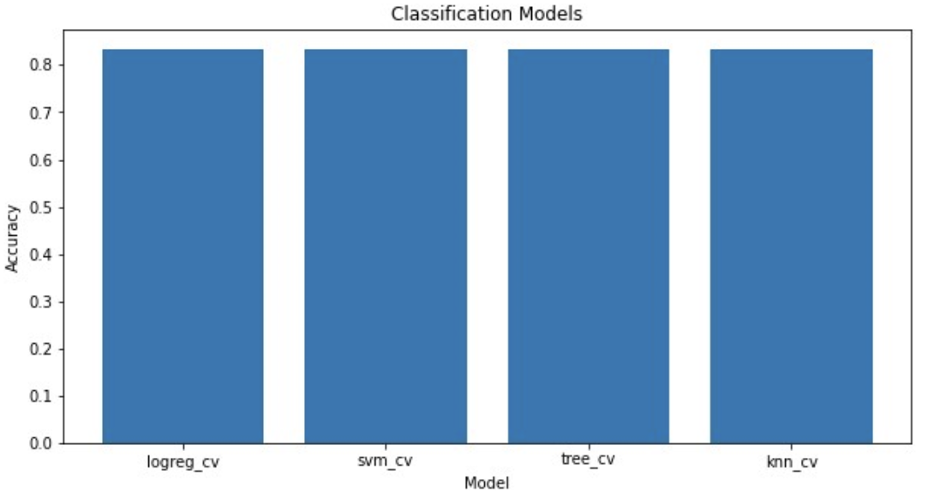
Classification Accuracy

Slide 47
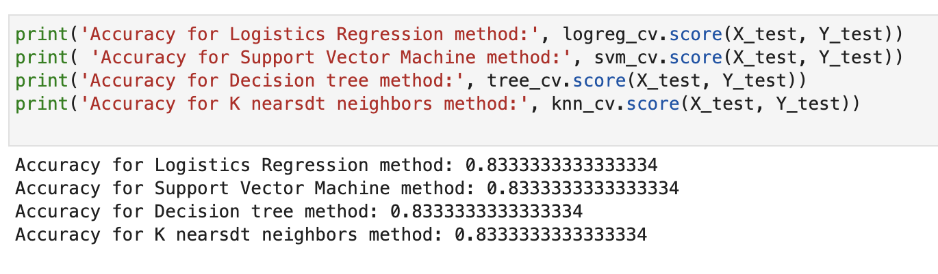
Classification Accuracy

Slide 48
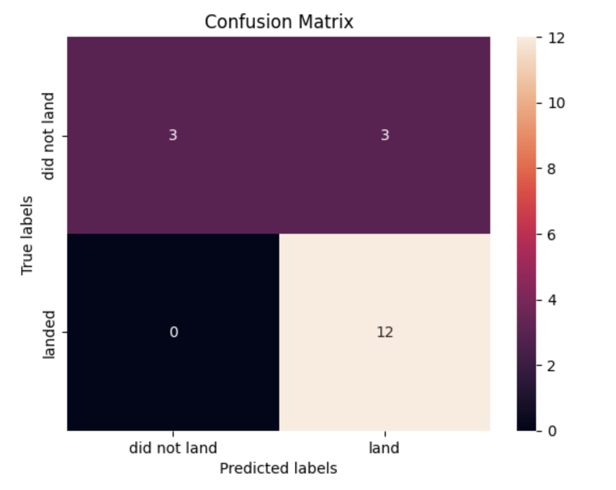
Confusion Matrix

Slide 49
Conclusions
Different data sources were analyzed, refining conclusions along the process
Launches above 7,000kg are less risky
Although most of mission outcomes are successful, successful landing outcomes seem to improve over time, according the evolution of processes and rockets
As all the algorithms are giving the same accuracy, they all perform practically the same.
By using our machine learning model, we can predict if the first stage of our competitor will land and determine the cost of a launch.

Slide 50
Appendix
For Jupyter notebook or code snippets or sql queries access the below Github repository Link
https://github.com/Sair07/Applied_data_science_capstone

Slide 51


